Slide 1

Comprehensive Active Shooter Incident Management (CASIM™)
From “Shots Fired” to “Shooter Down” and Beyond
With
Steven Crimando, MA, CTS, CHS-V Behavioral Science Applications

Slide 2

Intended Audience
First Responders
Victim Services providers
Federal, state and local agencies
Medical providers and hospitals
Mental health and substance abuse professionals
Policy makers and planners
NGOs and NPOs
Faith based organizations
Institutes of higher education
  2

Slide 3
Objectives
At the conclusion of this program, participants will know:
The scope and prevalence of mass shooting incidents
The unique psychosocial consequences of mass shootings
The characteristics and dynamics of Active Shooter incidents
Approaches for coordination of services
Strategies and techniques for providing psychosocial support
Tips for responder safety
Copyright © 2013. Behavioral Science Applications. All Rights Reserved.
  3

Slide 4
Behavioral Health Risk Factors
Because incidents of mass shootings, where there are multiple fatalities and/or injuries, are human-caused and with the intention of harming or killing others, among disasters they can be especially devastating to those that experience them, including:
Survivors of and witnesses to the incident
Loved ones of victims and survivors
First Responders, rescue & recovery workers
Neighbors and community members surrounding the incident, especially those in the area at the time the violence happened.
  4

Slide 5

Please Be Aware…
Mass violence incidents are emotionally powerful and discussion of such events can sometimes be uncomfortable.
Please be aware that this presentation involves discussion, photography and videos of real and simulated violence that may be unsettling.
All materials used in this presentation have specific learning objectives and are never used for “shock-value.”
If you become emotionally uncomfortable at any point in this presentation, please quietly exit and take a break. You can return at any point during or after the program.
NOTE: When this star appears in the upper right box it indicates that the next slide will feature a graphic image.
  5

Slide 6
Program Overview
Mass Shooting Incidents: Types, scope and prevalence
Incident Characteristics and Dynamics
Pyschosocial Impact of Mass Violence
Approaches to Behavioral Health Support
Psychological First Aid: Do’s & Don’ts
Responder Safety: Psychological and Physical
Table Top Exercise
  6

Slide 7
The General Mitigation Model
Understand the Hazard
Understand the Defense
Act in Time
Applied to the recognized hazard of an Active Shooter Incident.

Slide 8
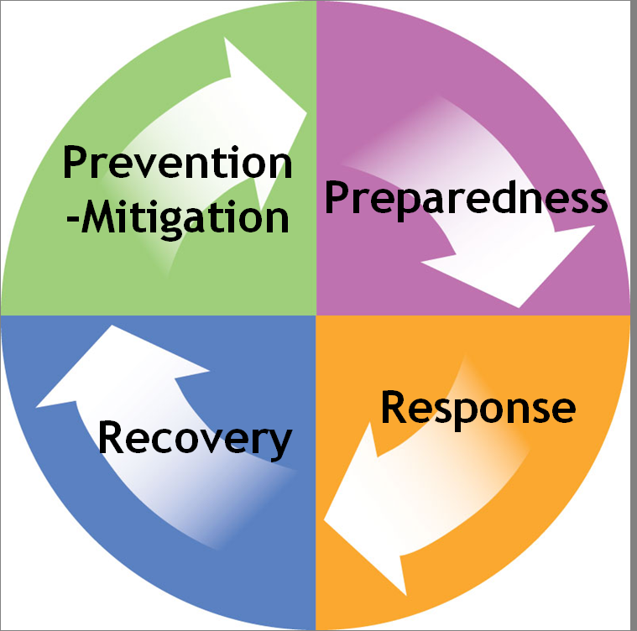
Comprehensive Active Shooter Incident Management CASIM™)
Mitigation
  Executive Buy-In
  Policies, Plans, Procedures
  Risk Assessment
Recovery
  Psych First Aid/Trauma Management
  Investigation
  Business Continuity
Preparedness
  Training
  Team Development
  Exercises/Drills
Response
  Threat Assessment
  Threat Management
  Notification
  Emergency Actions
  8

Slide 9
Mass Shooting Incidents
  9

Slide 10
On Mass Violence
"The death of one man is a tragedy, the death of millions is a statistic."
-Joseph Stalin
That's what Soviet dictator Joseph Stalin allegedly once said to U.S. ambassador Averill Harriman. And Stalin was an expert on the topic since his regime killed as many 43 million people.
It turns out that the mustachioed murderer may have been expressing an acute insight into human psychology.
  10

Slide 11

Case Study: Utøya Island Massacre
  11

Slide 12
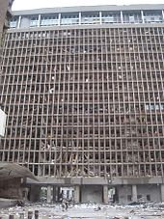
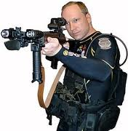
Norway: 22 July 2011
On the morning of July 22, 2011, a bomb made of fertilizer and fuel placed in a parked car detonated in the government section of Oslo, Norway.
The explosion killed eight people and injured at least 209 people, twelve of them seriously.
The second attack occurred less than two hours later at a youth summer camp on the island of Utøya.
A gunman dressed in a homemade police uniform and showing false identification gained access to the island and subsequently opened fire at the participants, killing 69 of them, and injuring at least 110.
Among the dead were personal friends of Prime Minister Jens Stoltenberg and the stepbrother of Norway's crown princess.
  12

Slide 13
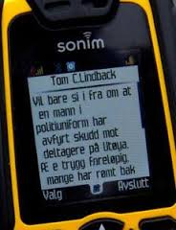
Video
Text Messages from Hell
  13

Slide 14
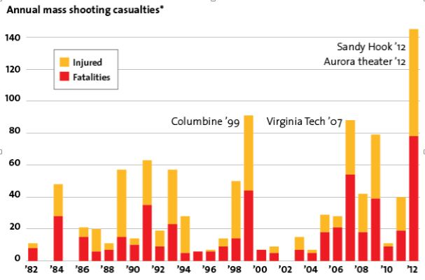
Mass Shootings:
Active Shooter Events (ASEs)
Data on "active shooter events" (ASEs) between 1982 and 2012 in which the killer's primary motive appeared to be mass murder.
  14

Slide 15
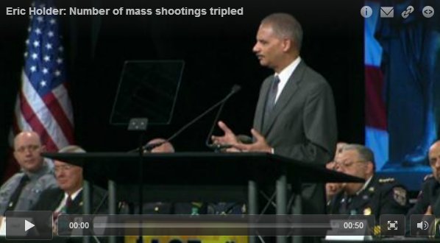
An Ongoing Problem
Between 2000 and 2008, the U.S. experienced an average of five mass shootings every year.
From 2009 through 2012, the annual average tripled.
From the Newtown, CT shooting in December 2012, up to AG Holder’s address, there had been another 13 mass shootings in the U.S.
U.S. Attorney General Eric Holder addressing the IACP Conference in Philadelphia. Oct. 21, 2013

Slide 16


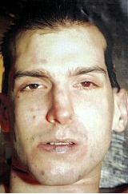
2012
February 21
Norcross, GA
Health Spa
4 Killed, + Shooter
February 27 Chardon, OH
HS Cafeteria
3 Killed, 2 Injured
March 8
Pittsburgh, PA
Psychiatric Hospital
1 Killed, + Shooter
7 Injured
2012 was one of the worst years for mass shootings in modern U.S. history.
  16

Slide 17
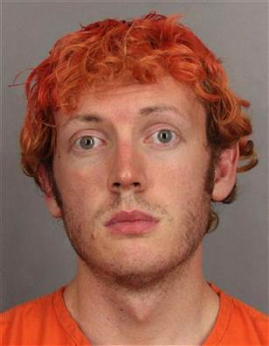

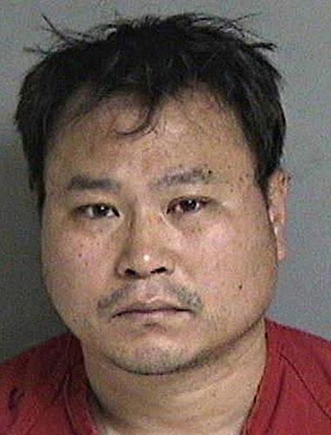
July 20
Aurora, CO
Movie Theater
12 Killed, 58 Injured
2012
May 30
Seattle, WA
Coffee Shop
5 Killed, + Shooter
1 Injured
April 2
Oakland, CA
University Classroom
7 Killed, 3 Injured
The toll from mass shootings in 2012 was nearly twice that of any other year.
  17

Slide 18
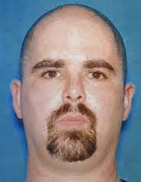


2012
August 5
Oak Creek, WI
Sikh Temple
6 Killed, + Shooter
3 Injured
September 27
Minneapolis, MN
Sign Company
6 Killed, + Shooter
3 Injured
October 21
Brookfield, WI
Spa/Salon
3 Killed, + Shooter
4 Injured
There is not one useful profile of the shooters, but there are meaningful commonalities.
  18

Slide 19


2012
December 11
Happy Valley, OR
Shopping Mall
2 Killed, + Shooter
1 Injured
There is much we can learn from these shooters and from these events…
December 14
Newtown, CT
Elementary School
27 Killed, + Shooter
2 Injured
  19

Slide 20

…to protect and assist our loved ones and communities from becoming the victims of these tragedies.
This is a foreseeable risk.
  20

Slide 21
Recent Incidents
Additional mass shooting incidents since the December 14, 2012 tragedy at Newtown, CT:
21 October 2013 - Sparks Middle School, Sparks, NV – 2 dead (including gunman), 2 wounded.
16 September 2013 – Navy Yard, Washington, DC- At least 12 dead (including gunman)
26 July 2013 –Apartment Complex, Hialeah, FL. -- 7 dead (including gunman)
7 June 2013 - Santa Monica College, Santa Monica, CA -- 6 dead (including gunman)
24 April 2013 – Federal Housing Complex, Manchester, IL -- 5 dead.
21 April 2013 – Apartment Complex, Federal Way, Wash. -- 5 dead (including gunman)
13 March 2013 - Herkimer County, N.Y. -- 5 dead (including gunman), one FBI K-9 dead.
  21

Slide 22

Not a New Threat
University of Texas: 1966
San Ysidro McDonalds: 1984
Luby’s Cafeteria: 1991
Columbine: 1999
Virginia Tech: 2007
Amish Schoolhouse: 2006
Mumbai: 2008
University of Texas, Austin Bell Tower.
  22
Notes:
Case studies of the Virginia Tech shooting, the Utyoya Island shooting in Norway, and the Newtown, Connecticut active shooter incidents suggest that the shooter were aware of, studied and learned from, and sought to out do other shooters.
It is important then, that operators also study the details and dynamics of major cases, learning about the motives and methods of the shooters, as well as what worked an what did not in response to the events. In each instance, the motives and methods vary, but results are tragically the same; the loss of countless innocent lives.
To fully understand the evolution of the active shooter threat, it is recommended that operators have a working knowledge of the following major active shooter incidents.
One of the first major active shooter incidents on record is the University of Texas bell tower sniper case. On August 1st, 1966, a student and former United States Marine, Charles Joseph Whitman killed seventeen and wounded thirty two others in a mass shooting rampage in and around the Tower on the University of Texas, Austin Campus.
Charles Joseph Whitman was an engineering student and former U.S. Marine who killed seventeen people and wounded thirty-two others in a mass shooting rampage in and around the Tower of the University of Texas in Austin. Before beginning the attack on campus, Whitman killed both his mother and his wife. He was ultimately shot and killed by police on the observation deck of the tower, where he was perched high above campus.
On July 18, 1984, James Oliver Huberty opened fire at the McDonald's in San Ysidro, California. He was armed with a 9 mm Uzi, a pump-action 12-gauge shotgun, and a 9 mm pistol. During the prolonged assault, lasting 77 minutes, Huberty shot and killed 21 people and wounded 19 others. The shooter fired 257 rounds of ammunition before he was fatally shot by a SWAT Team sniper.
October 16, 1991 was a sunny, warm day in Killeen, Texas. Luby’s Cafeteria, a popular lunch spot in this small town was crowd with regulars, when a suddenly a pickup truck crashed through the restaurant’s windows. Customers thinking there was an accident rushed to help but were greeted by a hail of bullets from the driver before he even stepped out of his truck. In what evolved to be the deadliest mass shooting in the U.S. until the Virginia Tech massacre in 2007. By the end of his siege, 35-year-old George "Jo Jo" Pierre Hennard, had shot and killed 24 people and wounded another 20 before killing himself.
There has been much written, and lessons from the Columbine High School mass shooting radically reshaped thinking about tactical response priorities and methods.
Twelve students and one teacher were killed in the infamous Columbine High School shooting on April 20, 1999, The attack was unique for many reasons, including the fact that their were two shooters, Eric Harris and his close friend, Dylan Klebold. The complex and well-planned attack involved a fire bomb to divert firefighters, propane tanks converted to bombs placed in the cafeteria, 99 explosive devices, and bombs rigged in cars. Both shooters took their own lives before they were reached by police.
Lessons were learned from Columbine by both law enforcement officers and would-be shooters. The 23 year old Virginia Tech student, Seung-Hui Cho also carefully prepared for his attack on April 16, 2007 and in the videos he prepared for the media prior to the shooting, mention "martyrs like Eric and Dylan.”
Cho was inspired by and sought to out do the Columbine shooters. He adjusted his tactics based on the new type of police response, firing 174 rounds of ammunition in just more than nine minutes. 32 were killed before Cho took his own life.
An Amish one-room school house was the scene of a deadly active shooter incident on October 2, 2006, when Charles Carl Roberts took those in the school house hostage, ultimately killing five and injuring five before killing himself.
And from Wednesday, November 26 through Sunday, November 29th, 2008, the Indian city of Mumbai was under siege during twelve highly coordinated shooting and bombing attacks by members of Lashkar-e-Taiba, a Pakistan-based militant group. The group of 11 attacked hotels, houses of worship and public places killing 164 people and wounding at least 308.
Each of these well-know cases involve different motives, strategies and tactics by the attackers, and required different types of response by police. In addition to recent cases, study of these historic incidents can provide law enforcement personnel and other operators with important information to better prepare for future incidents.

Slide 23
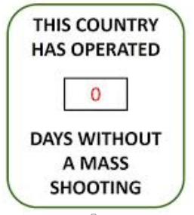
The Next Incident
The next incident of mass violence is already in progress, but you haven’t heard about it yet.
From the first radio call of “Shots Fired” to the last call of “Shooter Down,” the entire incident will likely only be 12 minutes in duration; Thirty-seven percent last less than 5 minutes.
The shooter began his meticulous preparation and planning months, sometimes years in advance.
The psychological, social and economic consequences of the incident may last decades, even a lifetime.
To effectively mitigate the operational risks of workplace violence, and the extreme violence of an Active Shooter Incident, you must adequately anticipate the entire lifecycle of the event.
  23

Slide 24
Incident Dynamics
Section 2
  24

Slide 25
Operational Definitions
Spree Killing: The U.S. Bureau of Justice Statistics defines a spree killing as "killings at two or more locations with almost no time break between murders.”
Serial Killing: The FBI defines serial killing as "a series of two or more murders, committed as separate events, usually, but not always, by one offender acting alone.“
Mass Murder: According to the FBI, mass murder is defined as the person murdering four or more persons during a particular event with no cooling-off period between the murders. A mass murder typically occurs in a single location in which a number of victims are killed by an individual or more. With exceptions, many acts of mass murder end with the death of the perpetrator(s), whether by direct suicide or being killed by law enforcement.

Slide 26
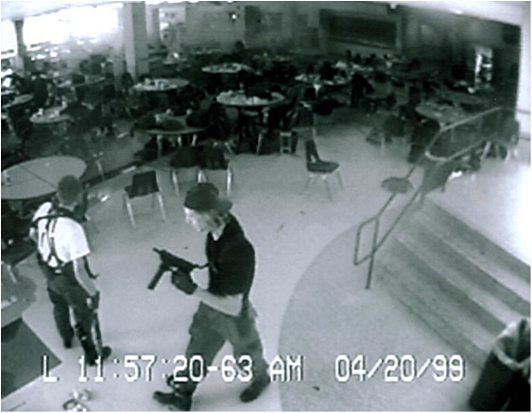
Definition:
Active Shooter
“An Active Shooter is an individual actively engaged in killing or attempting to kill people in a conﬁned and populated area; in most cases, active shooters use ﬁrearms(s) and there is no pattern or method to their selection of victims.”
-U.S. Department of Homeland Security, 2008
  While victim selection is often random, the violent attacks are not. They are meticulously planned, resourced, rehearsed, and methodically executed.
  26

Slide 27
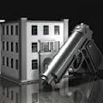
Analysis of Active Shooter Incidents
(n = 324)
1966-2012
Sources:
“Active Shooter: Recommendations and Analysis for Risk Mitigation, NYPD 2010 & 2012.
“Addressing the Problem of the Active Shooter” FBI Law Enforcement Bulletin, May 2013.
  27

Slide 28

Setting
School: 24%
Office Building: 11%
Open Commercial: 24%
Factory/Warehouse: 12%
Other: 29%
Source: NYPD “Active Shooter: Recommendations and Analysis for Risk Mitigation, 2010 & 2012.
  28

Slide 29
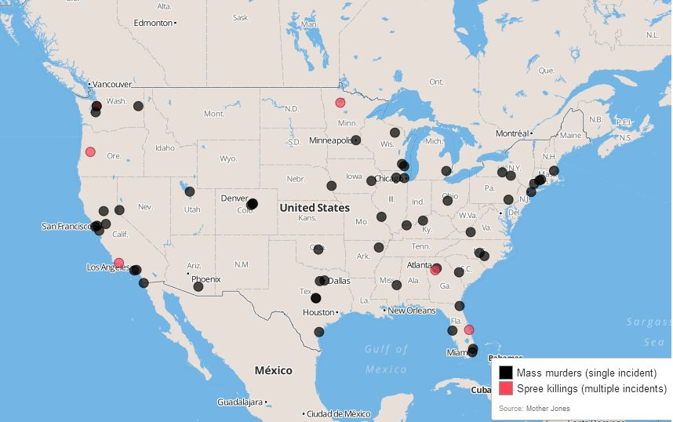
Geographic Location
Mass shootings: 1982-2012.
  29

Slide 30
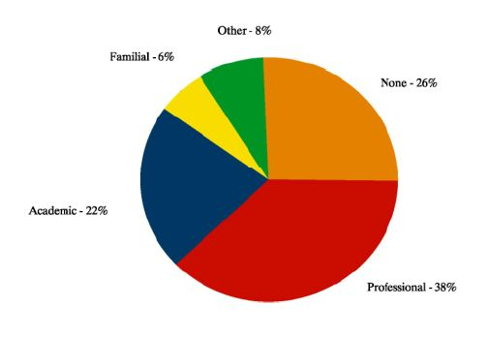
Relationship with Victims
Source: NYPD “Active Shooter: Recommendations and Analysis for Risk Mitigation, 2010 & 2012.
  30

Slide 31
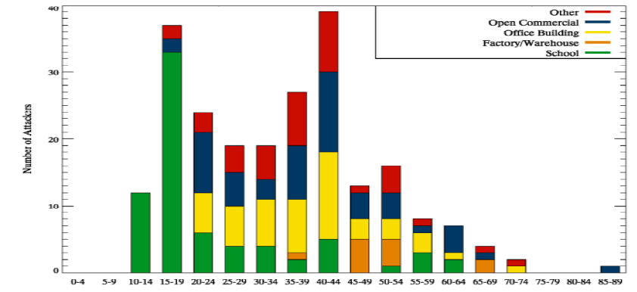
Age of Shooter
Bi-modal Distribution:
School Shooters: 15 to 19 y.o.
Other settings: 35-44 y.o.
Source: NYPD “Active Shooter: Recommendations and Analysis for Risk Mitigation.
  31

Slide 32
Incident Characteristics
Attacker Gender: 96% Male; 4% Female.
Number of Attackers: 98% single attacker; 2% two or more.
Weapons: 64% single weapon; 36% two or more. ¾ or more are purchased legally. 2/3 are semiautomatic handguns; the others are a mix of rifles, shotguns and revolvers.
2% of the shooters bring IEDs as an additional weapon.
Victims: A typical active shooter attack results in 0-2 deaths and 0-2 wounded.
Source: NYPD “Active Shooter: Recommendations and Analysis for Risk Mitigation, 2010 & 2012.
  32

Slide 33
Incident Characteristics (cont.)
The average active-shooter incident lasts 12 minutes. Thirty-seven percent last less than 5 minutes.
Forty-three percent of the time, the crime is over before police arrive. In 57 percent of the shootings, an officer arrives while the shooting is still underway.
The shooter often stops as soon as he hears or sees law enforcement, often turning his aggression on law enforcement officers.
Patrol officers are most likely responding alone or with a partner. When responding alone, 75 percent had to take action.
A third of those officers who enter the incident alone are shot by the intruder.
Source:
“Addressing the Problem of the Active Shooter” FBI Law Enforcement Bulletin, May 2013.
  33

Slide 34
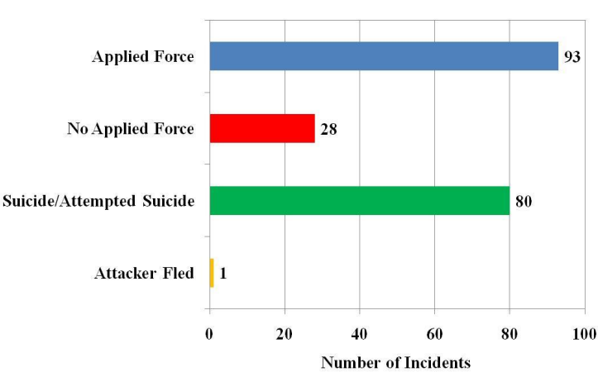
Incident Resolution
Source: NYPD “Active Shooter: Recommendations and Analysis for Risk Mitigation, 2010 & 2012.
  34

Slide 35

Types and Sources of Violence
  35

Slide 36

The Threat of Violence:
A Reality in the Modern Workplace
Like it or not, every organization is vulnerable to workplace violence, regardless of size or type. An incident of workplace violence can be devastating to an organization—to its bottom line, to employee morale, to employee retention and recruiting, and to its reputation and brand.
Chubb, “Managing Threats of Violence in the Workplace” 2012.
  36

Slide 37

A Foreseeable Operational Risk
Between 1992 to 2010, there were 13,827 workplace homicides, with an average of 700 per year.
Some 2.7 million assaults and threats are reported at work annually in North America.
Workplace violence represents a constant and serious threat to an organization’s:
  Safety and Security
  Business Continuity
  Employee Performance and Productivity
  Brand and Reputation
Low Probability- High Consequence Events,
But not “Black Swans.”
  37

Slide 38

Definition:
Workplace Violence
“Workplace Violence” is a much broader term than just “workplace homicide.”
The Bureau of Justice Statistics defines workplace violence as “violent acts against a person at work or on duty, including physical assaults (rape and sexual assault, aggravated and simple assault), and robbery.”
The phrases “at work” and “on duty” are used synonymously for the term “workplace.”
  38

Slide 39

Non-Fatal Violence on the Job
97% of workplace acts of violence are non-fatal, ranging from verbal threats to fist-fights, but…
But a substantial number of harassment offenses, threats, and attacks are thought to go unreported to management.
  39

Slide 40

Workplace Violence = Gun Violence
/
While the media tends to report on sensational workplace shootings, gun-related violence on the job is statistically rare.
Managers must expand their understanding of potential violence well beyond firearms.
Even a hot cup of tea or coffee can quickly become a weapon.
  40

Slide 41
Workplace Violence Continuum
Psychological
Physical
Active Shooter
Verbal
Weapons
Copyright © 2013. Behavioral Science Applications. All Rights Reserved.
  41

Slide 42
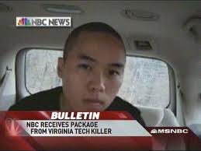
Motives
Desire for attention or recognition (Herostratus Syndrome)
Suicide or desperation
Attempt to solve a problem
Multiple motives
Revenge
Felt bullied/persecuted or threatened by others
-Source: US Secret Service
  42

Slide 43

Herostratus Syndrome
Herostratus was an arsonist. On July 21, 356 BC, seeking notoriety, he burned down the Temple of Artemis at Ephesus in ancient Greece (now Turkey). The temple was constructed of marble and measuring 425 feet long and supported by columns 60 feet tall.
The Temple of Artemis was one of the Seven Wonders of the Ancient World.
His name has become a metonym for someone who commits a criminal act in order to become famous.
  43

Slide 44
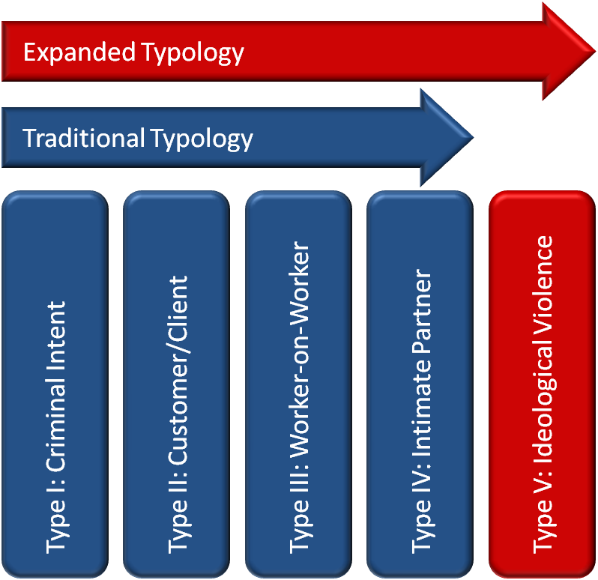
Violence Typology
  44

Slide 45
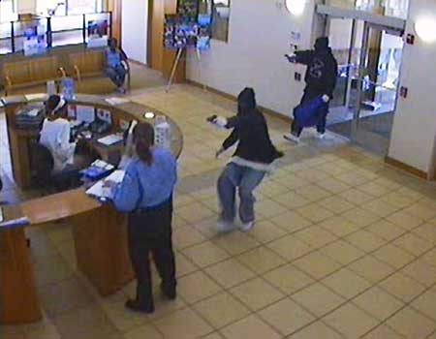
Type I: Criminal Intent
The perpetrator does not have any legitimate business relationship with the establishment.
The primary motive is usually theft.
A deadly weapon is often used, increasing the risk of fatal injury.
Workers who exchange cash, work late hours, or work alone are at greatest risk.
Copyright © 2013. Behavioral Science Applications. All Rights Reserved.
  45

Slide 46
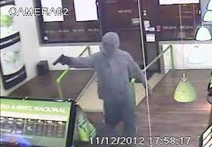
Type I: Criminal Intent (Cont.)
This most common type of workplace violence.
85% of all workplace homicides fall into this category.
These crimes include robbery, shoplifting and trespassing incidents that turn violent.
Copyright © 2013. Behavioral Science Applications. All Rights Reserved.
  46

Slide 47
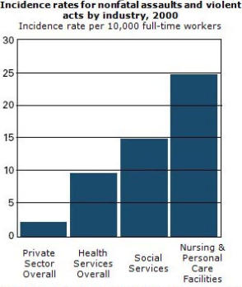
Type II: Customer/Client
The perpetrator is a customer or client of the worker/ organization.
The violence occurs in conjunction with the worker’s normal duties.
The risk to some workers may be constant (e.g., mental health workers, police) or routine.
Copyright © 2013. Behavioral Science Applications. All Rights Reserved.
  47

Slide 48
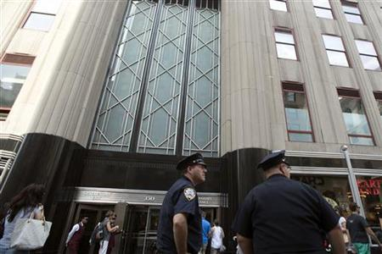
Type III: Worker-on-Worker/ Student-on-Student
The perpetrator is an employee or former employee of the organization.
The motivating factor is often one or a series of interpersonal or work-related conflicts, losses or traumas; A sense of injustice or unfairness.
Type III violence accounts for about 7% of all workplace homicides.
Managers and supervisors are at greatest risk of being victimized.
Example: Jeffrey Johnson, Hazen, Inc. Empire State Bldg., NYC. August 2012.
Copyright © 2013. Behavioral Science Applications. All Rights Reserved.
  48

Slide 49
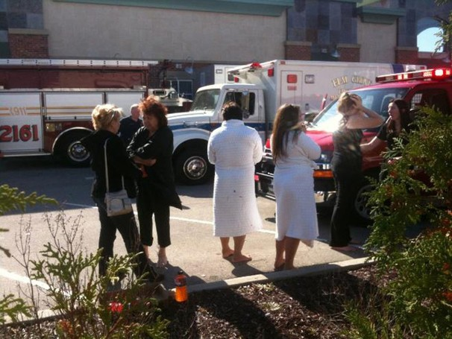
Type IV: Intimate Partner
A spillover of domestic violence into the workplace.
Typically refers to perpetrators who are not employees or former employees of the affected workplace.
Women are more often targets.
Example: Brookfield, WI. OCT. 21, 2012
Radcliffe Franklin Haughton killed three women and wounded four others before killing himself in a shooting at salon where his wife worked.
Copyright © 2013. Behavioral Science Applications. All Rights Reserved.
  49

Slide 50

Type V: Ideological Violence
Violence directed at an organization, its people and/or property for ideological, religious or political reasons, by individuals or groups.
Violence perpetrated by extremists, “value‐driven” groups and other “true believers” also fall within this category.
Target selection is not based on sense of personal or professional injustice in the workplace, but rather rage against what the targeted organization does or represents.
Example: 40 year old white supremacist, Wade Michael Page, shot and killed 6 and himself at a Sikh Temple in Wisconsin.
  50

Slide 51
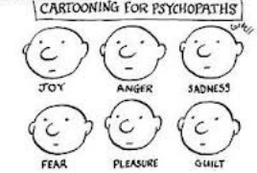
Defining Psychopathy:
A constellation of cognitive, affective and behavioral traits.
Lack of empathy coupled with aggression.
Lack of remorse for wrongdoing.
Shallowness of emotions.
Projection of blame on others.
Slick, manipulative, pushy.
Extremely egocentric, narcissistic.
Intense sense of entitlement or injustice.
Does not read or respond well to social cues.
  51
Notes:
12/1/2013
Copyright MJZagury and Associates LLC
51

Slide 52


Video Case Study
The Laura Black Case
from the HBO Film
“Murder 9 to 5”
  52

Slide 53

Defining Psychopathy:
A constellation of cognitive, affective and behavioral traits.
Lack of empathy coupled with aggression.
Lack of remorse for wrongdoing.
Shallowness of emotions.
Projection of blame on others.
Slick, manipulative, pushy.
Extremely egocentric, narcissistic.
Intense sense of entitlement or injustice.
Does not read or respond well to social cues.
  53
Notes:
12/1/2013
Copyright MJZagury and Associates LLC
53

Slide 54
Reactive vs. Proactive Violence
Reactive
Intense ANS arousal
Subjective experience of emotion
Reactive and immediate violence
Internal or external threat
Goal: Threat reduction
Proactive
Minimal or no ANS
No conscious emotion
Planned and purposeful
No or minimal threat
Goal: Multiple/many
  54
Notes:
12/1/2013
Copyright MJZagury and Associates LLC
54

Slide 55
Reactive vs. Proactive Violence (cont.)
Proactive
Behavior not time-limited
Preceded by private ritual
Primarily cognitive-conative
Focused awareness
Reactive
Time-limited behavior
Preceded by pubic posturing
Heightened and diffuse awareness
  55
Notes:
12/1/2013
Copyright MJZagury and Associates LLC
55

Slide 56

Neuroscience of Violence
Control Proactive Reactive
PET scan detects glucose metabolism in various parts of the brain illustrating activity/non-activity.
Want to know more? “The Anatomy of Violence: The Biological Roots of Crime” by Raine, Adrian (Apr 30, 2013).
  56
Notes:
12/1/2013
Copyright MJZagury and Associates LLC
56

Slide 57
Subject
Pre-operational
  Grievance: Real or perceived
  Violent Ideation
Planning
  Research/ Surveillance
  Acquiring Supplies
  Practice/Dry Run
  Probing & Breaches
Attack
  Strategy and tactics
  No exfiltration strategy
  Maximum carnage
Post-Attack
  Suicide
  Prolonged investigation, publicity, media coverage
  Ongoing traumatization to individuals, organizations and communities.
Target
Mitigation
  Executive Support
  Risk/Vulnerability Assessment
  Development of Policies, Plans and Procedures
Preparedness
  Training: Awareness and Skills
  Threat Assessment/Management Team Development
  Exercises and Drills
Response
    Run>Hide>Fight
    Employee/Family Reunification Center
    Liaison with ICS/Responders
    Crisis Communications/Media Management
  Recovery
    Business Continuity
    Alternate locations
    Crime scene clean up
    Investigation
    Trauma Management
Incident Lifecycle
Copyright © 2013. Behavioral Science Applications. All Rights Reserved.
  57

Slide 58
Mitigation
Mitigation
  Executive Buy-In
  Policies, Plans, Procedures
  Risk Assessment
Recovery
  Psych First Aid/Trauma Management
  Investigation
  Business Continuity
Preparedness
  Training
  Team Development
  Exercises/Drills
Response
  Threat Assessment
  Threat Management
  Notification
  Emergency Actions
  58

Slide 59

Mitigation
Definition: The elimination or reduction of the frequency, magnitude, or severity of exposure to risks, or minimization of the potential impact of a threat or warning.
Leaders and decision-makers should be aware of the scope and magnitude of the problem, relevant regulations and standards, and the potential impact on operations and brand.
  59

Slide 60

The Cost of Workplace Violence
The cost of reacting after a serious incident has occurred is 100 times more costly than taking preventative actions.
Also consider the impact on:
Morale/Performance
Business Continuity
Recruitment/Retention
Brand/Image
Nixon, W. Barry, The Financial Impact of Workplace Violence, National Institute for Prevention of Workplace Violence, Inc., ISBN 0-9749403-4-8.
  60

Slide 61
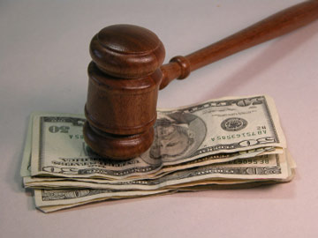
HR & Legal Concerns
OSHA’s General Duty Clause
Negligent Hiring
Negligent Supervisor
Negligent Retention
ADA and EEOC Issues
Workers Compensation
Wrongful Death Suits
Others
  61

Slide 62

Occupational Safety and Health Act
The OSH Act of 1970 mandates that, in addition to compliance with hazard-specific standards, all employers have a “general duty” to provide their employees with a workplace free from recognized hazards likely to cause death or serious physical harm.
See: OSHA Directive CPL 02-01-052, (2011, September 8). Enforcement Procedures for Investigating or Inspecting Workplace Violence Incidents.
The scope and prevalence of this problem makes workplace violence a recognized foreseeable risk.
Copyright © 2012. Behavioral Science Applications. All Rights Reserved.
  62

Slide 63
The American National Standard
"No organization, large or small, public or private, for-profit or in the nonprofit sector, can assume that it will be immune to the wide range of disturbing, threatening, and violent conduct that falls within the broad definition of "workplace violence." All organizations ultimately carry a responsibility, both for humanitarian and legal reasons, to protect employees and others who interact with the workplace to the fullest practical extent by taking measures to detect threats at the earliest possible moment, engage in effective intervention through careful Incident Management, and mitigate consequences should violence erupt."
-from the "American National Standard in Workplace Violence Prevention and Intervention (ASIS/SHRM WPVI.1-2011)
  63

Slide 64

Elements of a Violence Program*
*Note: A “Program,” not a “Plan.”
Management commitment and employee involvement
Risk Evaluation
Hazard Controls
Workplace Violence Prevention Policy
Employee Training
Record Keeping System
Program Evaluation
  64

Slide 65

Violence Policy Statement
Demonstrates top management's concern and commitment to their employees' safety and health.
More than 70 percent of U.S. workplaces do not have a formal program or policy in place that addresses workplace violence, according to the Bureau of Labor Statistics’ recent “Survey of Workplace Violence Prevention.”
Having a policy without taking additional steps may create additional risk.
"A danger foreseen is half avoided."
-- Cheyenne Proverb
  65

Slide 66

Risk Assessment
Review of Internal Information, Practices and Procedures
Review of Historical Data: Case Files
Surveys and Key Informant Interviews
Work Site Audit: Physical/Facilities and Job Hazard Analysis
Violence Prevention Training Review
Threat Assessment and/or Incident Management Team: Operational and Training Review

Slide 67
Preparedness
Mitigation
  Executive Buy-In
  Policies, Plans, Procedures
  Risk Assessment
Recovery
  Psych First Aid/Trauma Management
  Investigation
  Business Continuity
Preparedness
  Training
  Team Development
  Exercises/Drills
Response
  Threat Assessment
  Threat Management
  Notification
  Emergency Actions
  67

Slide 68
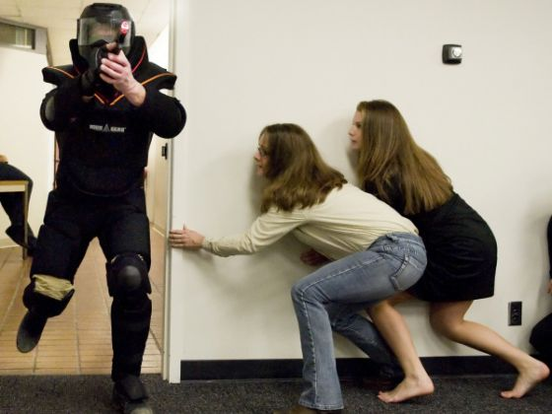
Training & Development
Awareness Level
  Executive Level
  Supervisor Level
  General Workforce Awareness Level
  Intimate Partner Violence Awareness
  Mobile Worker Safety
  Mental Illness in the Workplace
    others
Skill-building Level
  Threat Assessment Team Development
  Aggression & Rage Management
  Active Shooter Response
  Psychological First Aid
  Telephone Threat Management
Let’s Focus on TAT development
Copyright © 2013. Behavioral Science Applications. All Rights Reserved.
  68
Notes:
Application to Active Shooter Response
Pre-event training improves response. Employees benefit from training in the warning signs of workplace violence and terrorism, as well as clear instructions and practice in the appropriate response actions, specifically how to :
Evacuate
Hide
Take action
Walking and talking people through Active Scenarios provides an opportunity for mental rehearsal and may improve survivability. Don’t be afraid of frightening people. Address the fears of front line employees proactively. Let them know that you “get it”, you know that an Active Shooter situation is terrifying to think about or talk about, that most people don’t even want to think of such things, but that discussing this issue can improve their safety and the safety of those around them.

Slide 69
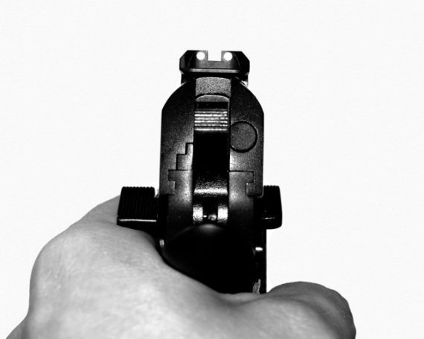
Case Vignette
Robert is overheard by a co-worker while making a call on his mobile phone. According to the co-worker, Robert clearly stated, “I’ve had it with all of them! I am bringing that gun tomorrow and I’ll take care of this once and for all at the team meeting!”
Is this a threat of violence?
  69

Slide 70
Threat or Plan?
The 3 T’s
Target
Timing
Type
Copyright © 2013. Behavioral Science Applications. All Rights Reserved.
  70
Notes:
12/1/2013
Copyright MJZagury and Associates LLC
70

Slide 71
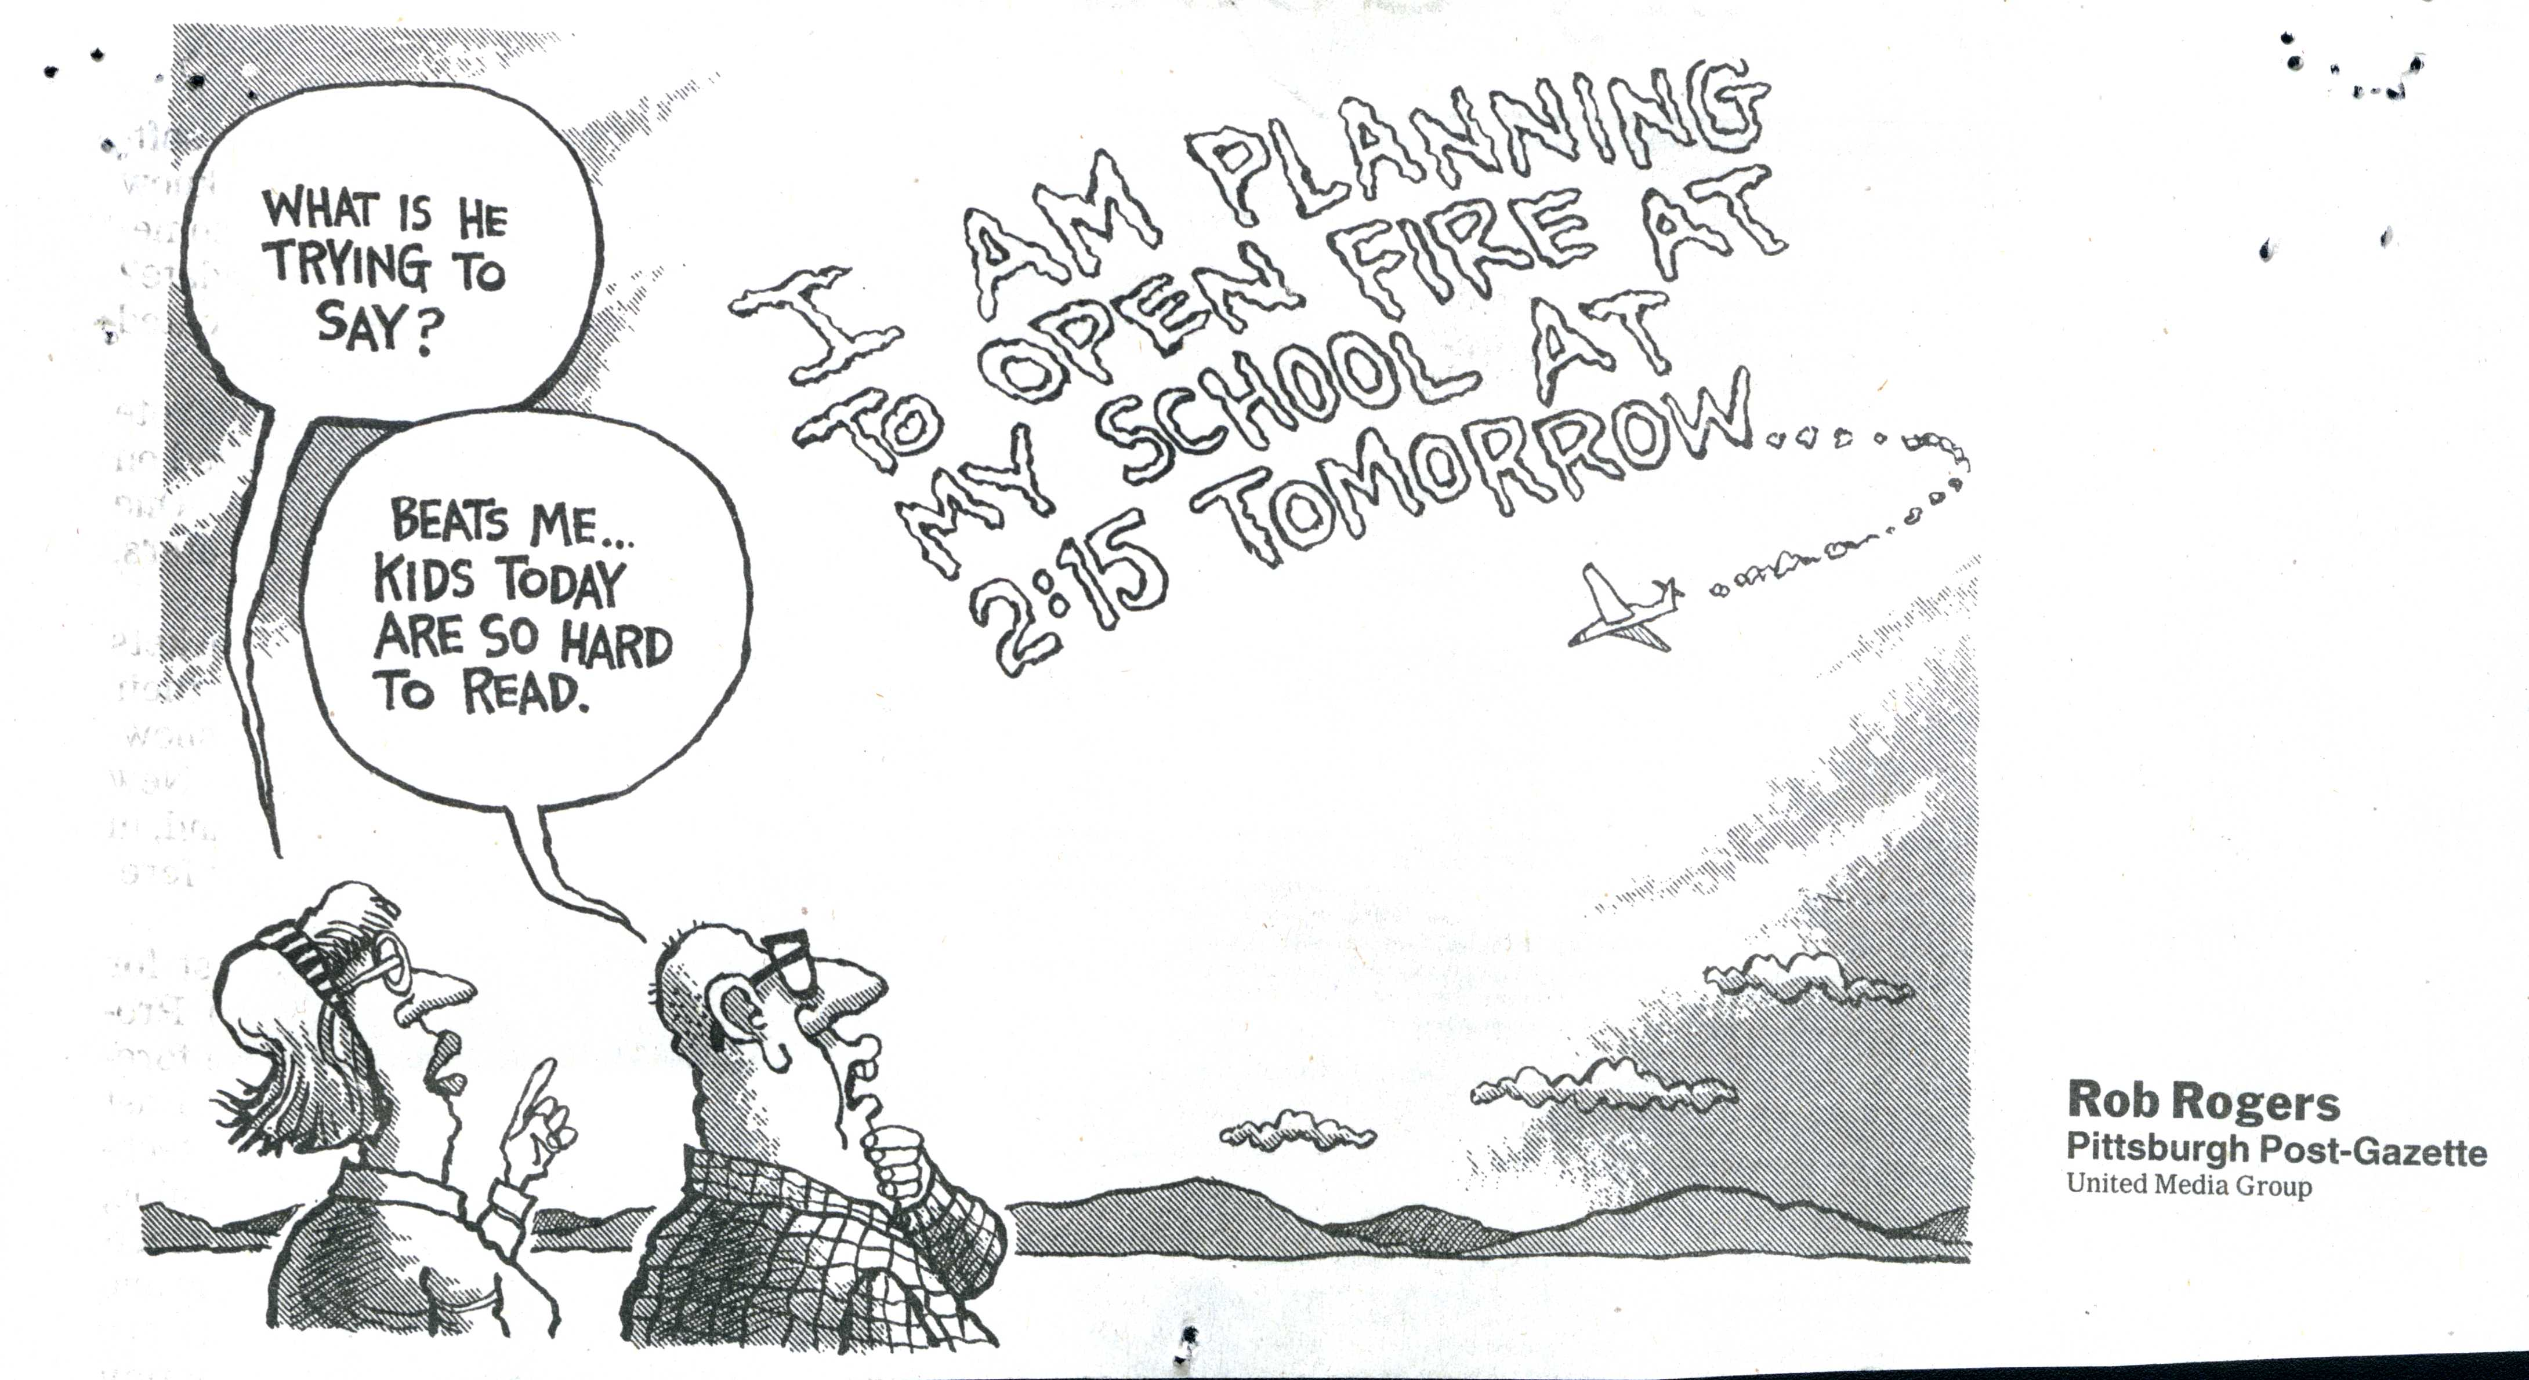
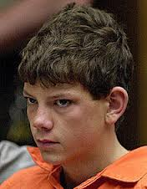
At 14, Charles Andrew Williams shot and killed 2, and injured 13 in the Santee, CA School shooting. Williams used a .22 revolver. He told investigators, that he was "tired of being bullied.
March 5, 2001.
  71
Notes:
12/1/2013
Copyright MJZagury and Associates LLC
71

Slide 72
A Distinction
Making a Threat vs. Posing a Threat
  Individuals can make threats with no intention or ability to act on them.
  Individuals can pose a threat without ever making a threat.
  Individuals can both make threats and pose threats to your safety.
Ultimately, it is more important to know if someone poses a threat, than if they have made a threat.
  72

Slide 73
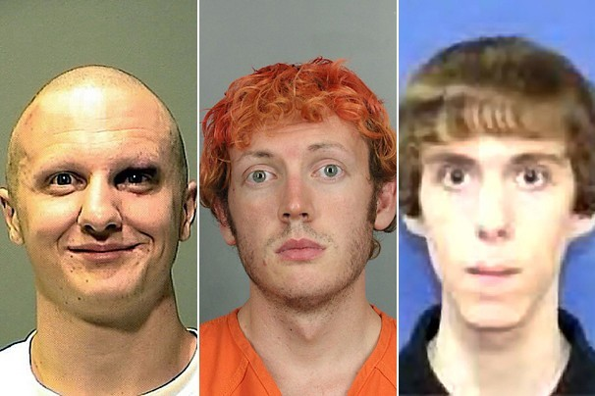
No Useful Profile,
But Important Commonalities
  73

Slide 74
Pathway to Violence
Attack
Probing & Breaches
Final Acts
Pre-attack Preparation
Research & Planning
Escalation De-escalation
Violent Ideation
Decision
Grievance
Calhoun & Weston, 2003
  74

Slide 75

The Role of Warning Behaviors
Research is increasingly pointing away from individual personality traits as useful indicators of risk, and towards patterns of behavior and communication referred to as “Warning Behaviors.”
Warning Behaviors are acute and dynamic correlates of risk:
  They are accelerants—focus on accelerating change.
  Patterns of behavior rather than individual risk factors.
The Role of Warning Behaviors (Meloy et al., Behavioral Sciences and the Law, 29:2011)
  75

Slide 76

Established Warning Behaviors
Pathway
Fixation
Identification
Novel aggression
Energy burst
Leakage
Directly communicated threat
Last resort behavior
  76

Slide 77
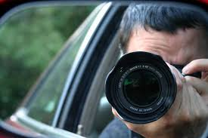
Pathway Warning Behavior
Pathway warning behavior – any behavior that is part of research, planning, preparation, or implementation of an attack (Calhoun & Weston, 2003; Fein & Vossekuil, 1998, 1999).
  77

Slide 78
Fixation Warning Behavior
Fixation warning behavior – any behavior that indicates an increasingly pathological preoccupation with a person or a cause (Mullen et al., 2009). It is measured by:
increasing perseveration on the person or cause;
increasingly strident opinion;
increasingly negative characterization of the object of ﬁxation;
impact on the family or other associates of the object of ﬁxation, if present and aware;
angry emotional undertone. It is typically accompanied by social or occupational/Academic deterioration.
  78

Slide 79
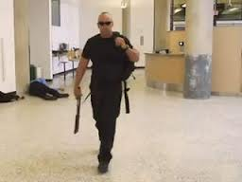
Identification Warning Behavior
Identification warning behavior – any behavior that indicates a psychological desire to be a “pseudo-commando” (Dietz, 1986; Knoll, 2010), have a “warrior mentality,” (Hempel et al., 1999), closely associate with weapons or other military or law enforcement paraphernalia, identify with previous attackers or assassins, or identify oneself as an agent to advance a particular cause or belief system.
  79

Slide 80
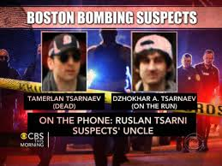
Novel Aggression Warning Behavior
Novel aggression warning behavior – an act of violence which appears unrelated to any targeted violence pathway warning behavior which is committed for the ﬁrst time.
Such behaviors may be utilized to test the ability (de Becker, 1997) of the subject to actually do a violent act, and may be a measure of response tendency, the motivation to act on the environment (Hull, 1952), or a behavioral tryout (MacCulloch, Snowden, Wood, & Mills, 1983).
When homicide occurs within this warning behavior, it may be “proof of kill” (G. Deisinger, personal communication, February, 2011).
  80

Slide 81

Energy Burst Warning Behavior
Energy burst warning behavior – an increase in the frequency or variety of any noted activities related to the target, even if the activities themselves are relatively innocuous, usually in the days or weeks before the attack (Odgers, et al., 2009).
  81

Slide 82
Leakage Warning Behavior
Leakage warning behavior – the communication to a third party of an intent to do harm to a target through an attack (Meloy & O’Toole, 2011).
The communication to a third party of an intent to do harm to a target through an attack.
In adult mass murders*, 67% had leaked intent to third parties before an attack.
In adolescent mass murders, 58% leaked information prior to attacks.
In an FBI study of school shooters ALL (100%) engaged in some sort of pre-attack leakage.
* Using the FBI definition, “mass murder” indicates three or more people killed in a single incident. Adult here means a subject >18 y.o.
  82

Slide 83

Methods & Themes of Leakage
Methods of Leakage
Threats: overt, veiled, innuendos, etc.
Diary/Journal entries
Social media/web postings
Doodling/Artwork
Video/Audio recordings
Themes of Leakage
Violence/ Suicidality
Hopelessness/Despair
Hatred/ Vengeance
Isolation/ Loneliness
Nihilism /“End of the World”
  83

Slide 84

Directly Communicated Threat Warning Behavior
Directly communicated threat warning behavior – the communication of a direct threat to the target or law enforcement beforehand. A threat is a written or oral communication that implicitly or explicitly states a wish or intent to damage, injure, or kill the target, or individuals symbolically or actually associated with the target.
  84

Slide 85

Last Resort Warning Behavior
Last resort warning behavior – evidence of a violent “action imperative” (Mohandie & Duffy, 1999), increasing desperation or distress through declaration in word or deed, forcing the individual into a position of last resort. There is no alternative other than violence, and the consequences are justiﬁed (de Becker, 1997). The subject feels trapped (S. White, personal communication, October, 2010).
  85

Slide 86
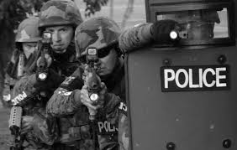
Emergency Actions: Incident Dynamics
Copyright © 2013. Behavioral Science Applications. All Rights Reserved.

Slide 87
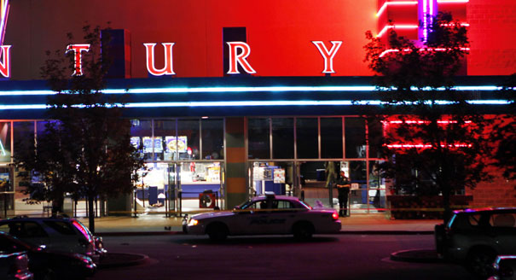
Incident Dynamics: Operational Assumptions [1]
Consider the environment inside an Mass Violence scenario:
The Attackers have selected a location that offers a target rich environment, therefore, there are likely to be many casualties.
The Attackers will seek to create the highest body count as possible. There may be an overwhelming number of injured and dead.
Expect carnage and complete chaos, noise, confusion, alarms with frightened people running and hiding and unwilling or unable to respond to directions.
  87
Notes:
To mentally prepare for an active shooter incident it is important to make accurate operational assumptions.

Slide 88
Operational Assumptions [2]
This is a dynamic, chaotic, hostile environment that will thrust citizens and responders into a spontaneous deadly force encounter.
Responding officers may or may not be trained and equipped for an Mass Violence incident.
Multiple weapons and ammunition are often involved .
At least initially, the Attacker typically has the tactical advantage. He may have months of preparation for the attack; responders are called to action with little or no warning.
Ordinary citizens are likely to have little or no mental or physical preparation for such a terrifying violent event.

Slide 89
Operational Assumptions: “Hot Zone”
Both citizens and responders are likely to encounter an overwhelming level of sensory stimulation, including, but not limited to:
Extreme levels of noise from alarms and people screaming which may interfere with communications.
Activated fire suppression and sprinkler systems.
Confusion and a friendly fire threat.
Victims hiding and frightened-not responding to law enforcement directions.
Exposure to physical carnage and multiple, graphic and traumatic injuries.
Potential presence of explosive devices.

Slide 90
Psychological Threats
In addition to the physical threat presented by the attack, the situation is likely to entail several foreseeable psychological hazards, including:
High-level of personal threat
Child victims
Prolonged/protracted incident (esp. if evolving to barricade or hostage situation)
High media interest
Personal knowledge of a victim(s)
Possible Line of duty death
Serious injury to self/colleagues
Multiple casualties
Killing or wounding innocent persons
Copyright © 2013. Behavioral Science Applications. All Rights Reserved.

Slide 91
Response
Mitigation
  Executive Buy-In
  Policies, Plans, Procedures
  Risk Assessment
Recovery
  Psych First Aid/Trauma Management
  Investigation
  Business Continuity
Preparedness
  Training
  Team Development
  Exercises/Drills
Response
  Threat Assessment
  Threat Management
  Notification
  Emergency Actions
Let’s Focus on Emergency Actions
  91

Slide 92
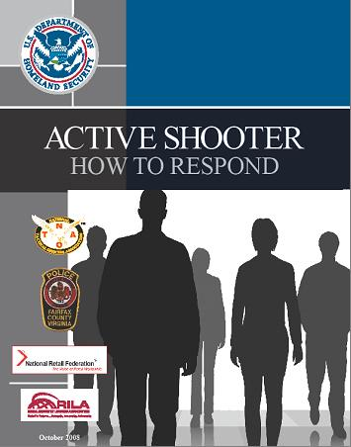
Active Shooter Response
Based on U.S. Department of Homeland Security recommendations.
  92

Slide 93
Response Priorities
The key to survival is a proactive mindset.
Take care of yourself.
Go to safety.
Get out of the line of fire.
Take as many people to safety as possible.
Run if you can,
Hide if you can’t,
Fight if you must.
  93

Slide 94

Video
Run>Hide>Fight:
Surviving an Active Shooter Event
  Time: 5 minutes. 55 seconds.
  94

Slide 95
Active Shooter: The Leaders’ Response
Employees and customers are likely to follow the lead of managers during an emergency situation. During an emergency, managers should be familiar with their Emergency Actions Plans and be prepared to:
Take immediate action.
Remain calm .
Lock and barricade doors.
Evacuate employees and customers via a preplanned evacuation route to a safe area.
Assist individuals with Special Needs and/or Disabilities.
Ensure that plans, evacuation instructions and any other relevant information is available.
Address to individuals with special needs and/or disabilities.
  95

Slide 96
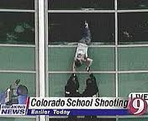
Evacuate
If there is an accessible escape path, attempt to evacuate the premises. Be sure to:
Have an escape route and plan in mind.
Evacuate regardless of whether others agree to follow.
Leave your belongings behind.
Help others escape, if possible.
Prevent individuals from entering an area where the active shooter may be.
Keep your hands visible.
Follow the instructions of any police officers.
Do not attempt to move wounded people.
Call 911 when you are safe.
  96

Slide 97

Hide Out
If evacuation is not possible, ﬁnd a place to hide where the active shooter is less likely to ﬁnd you.
Your hiding place should:
  Be out of the active shooter’s view.
  Provide protection if shots are ﬁred in your direction (i.e., an ofﬁce with a closed and locked door)
  Do not trap you or restrict your options for movement
To prevent an active shooter from entering your hiding place:
  Lock the door
  Blockade the door with heavy furniture
  97

Slide 98

If the Shooter is Nearby
Lock the door.
Silence your cell phone and/or pager.
Turn off any source of noise (i.e., radios, televisions).
Hide behind large items (i.e., cabinets, desks).
Remain quiet.
If evacuation and hiding out are not possible:
Remain calm.
Dial 911, if possible, to alert police to the active shooter’s location.
If you cannot speak, leave the line open and allow the dispatcher to listen.
  98

Slide 99
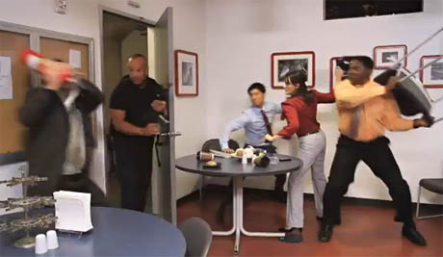
Take Action
As a last resort, and only when your life is in imminent danger, attempt to disrupt and/or incapacitate the active shooter by:
Acting as aggressively as possible against him/her.
Throwing items and improvising weapons.
Yelling.
Committing to your action.
When the shooter is at close range and you cannot flee, your chance of survival is much greater if you try to incapacitate him/her.
  99

Slide 100

When Calling 9-1-1
Try to provide as much of the following information as possible:
Location of the active shooter.
Number of shooters, if more than one.
Physical description of shooter/s.
Number and type of weapons held by the shooter/s.
Number of potential victims at the location.
The first officers to arrive to the scene will not stop to help injured persons.
  100

Slide 101
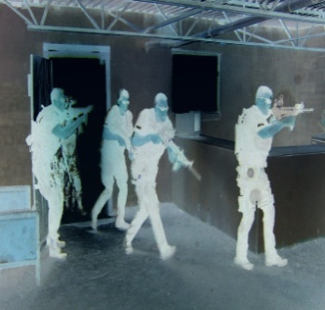
When Law Enforcement Arrives [1]
Law enforcement’s purpose is to stop the active shooter as soon as possible.
Ofﬁcers will proceed directly to the area in which the last shots were heard.
Ofﬁcers may arrive and enter the scene alone or in teams.
Ofﬁcers may wear regular patrol uniforms or external bulletproof vests, Kevlar helmets, and other tactical equipment. Some may be in plain clothes.
Ofﬁcers may be armed with riﬂes, shotguns, handguns.
Ofﬁcers may use pepper spray or tear gas to control the situation.
Ofﬁcers may shout commands, and may push individuals to the ground for their safety.
  101

Slide 102
When Law Enforcement Arrives [2]
Expect rescue teams comprised of additional officers and emergency medical personnel to follow the initial officers. These rescue teams will treat and remove any injured persons. They may also call upon able-bodied individuals to assist in removing the wounded from the premises.
Once you have reached a safe location or an assembly point, you will likely be held in that area by law enforcement until the situation is under control, and all witnesses have been identified and questioned.
Do not leave until law enforcement authorities have instructed you to do so.
  102

Slide 103
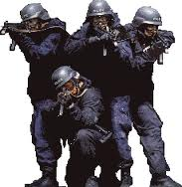
Surviving a Rescue
How to react when law enforcement arrives:
Remain calm, and follow ofﬁcers’ instructions.
Put down any items in your hands (i.e., bags, jackets and especially cell phones).
Immediately raise hands and spread ﬁngers.
Keep hands visible at all times.
Avoid making quick movements toward ofﬁcers such as holding on to them for safety.
Avoid pointing, screaming and/or yelling.
Do not stop to ask ofﬁcers for help or direction when evacuating, just proceed in the direction from which ofﬁcers are entering the premises.
Hands Up, Open & Empty!
  103

Slide 104
Recovery
Mitigation
  Executive Buy-In
  Policies, Plans, Procedures
  Risk Assessment
Recovery
  Psych First Aid/Trauma Management
  Investigation
  Business Continuity
Preparedness
  Training
  Team Development
  Exercises/Drills
Response
  Threat Assessment
  Threat Management
  Notification
  Emergency Actions
  104

Slide 105
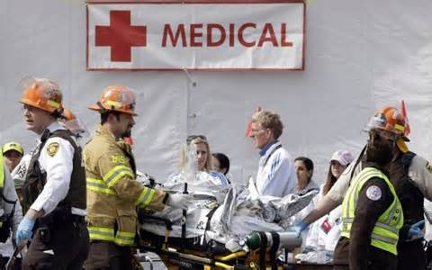
Immediate Post-Incident Actions
Provide for basic needs.
Establish Family Assistance/Reunification Center.
Provide Psychological First Aid/Emotional Support.
Crisis Communications/Media Management.
Liaison with hospitals.
Coordinate Crime Scene Management, such as Witness Statements with LEOs.
  105

Slide 106
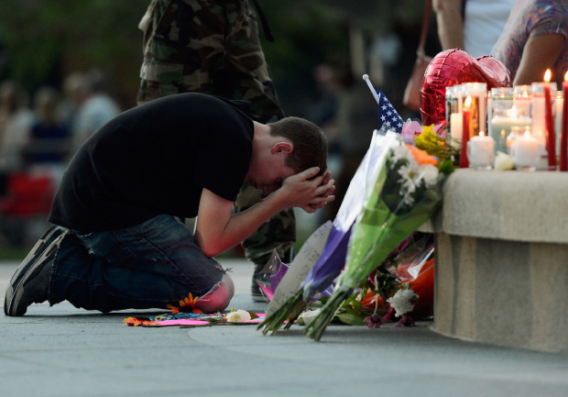
Early-Stage Recovery
Mobilize and coordinate services with other providers for early and ongoing emotional support.
Anticipate vigils, funerals and memorials.
Consider need for alternate sites/work from home.
Coordinate with local and federals victim support agencies. (Ex.: FBI VARDT)
Support Incident Command and Public Information Officers with information about impact and coping.
  106

Slide 107
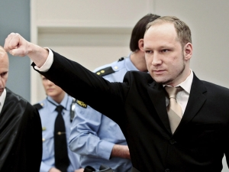
Mid-Stage Recovery
Anticipate litigation: Criminal and civil.
Begin planning for one year anniversary.
Continue ongoing support for victim’s families, survivors and witnesses, including medical and psychological care.
Develop After Action Report and conduct necessary reviews and updates to policies, plans and procedures.
Continue to monitor media coverage (including social media) of incident and organizational response.
Anders Behring Breivik murdered 77 people in July 2011. He used his trial as a platform to continue publicizing his extreme views for more than a year after the incident.
  107

Slide 108

Late-Stage Recovery
Recognize one year anniversary.
Anticipate emotional difficulty for some/many at anniversary times.
Manage anniversary media attention.
Support ongoing rehabilitation and mental health care for affected individuals.
  108

Slide 109
The Psychosocial Impact of Mass Shooting
  109

Slide 110
Key Concepts in Disaster Behavioral Health
The human response to disaster is phase-specific.
The human response to disaster is hazard-specific.
There is no “one-size-fits-all” approach to intervention…it must be tailored to the phase and nature of the incident.
  110

Slide 111
Extreme Psychological Trauma
Certain traumatic events, such as shooting, kidnapping and torture present even greater mental health challenges than other forms of disaster.
Three factors distinguish these traumas from other forms of violence and make them particularly toxic:
Victims are typically held against their will
The injury is intentional and personally directed
Pain is often inflicted for the purposes of punishment, coercion or perpetrator pleasure
  111

Slide 112

Ripley’s Dread Factor
Dread = Uncontrollability + Unfamiliarity
+ Unimaginability + Suffering
+ Scale of Destruction + Unfairness
Incidents of Mass Violence typically have a very high “dread factor.”
From Ripley, A. 2008. “Unthinkable: Who Survives Disaster When Disaster Strikes and Why”
  112

Slide 113
Post-incident Psychological Effects
The psychological consequences of directly experiencing or witnessing a mass shooting are often serious.
Prevalence of post-disaster diagnoses (predominantly PTSD) in studies ranged from 10% to 36%.
Much higher percentages reported sub-threshold PTSD, and very few participants reported no symptoms. (Norris et al., 2002a; 2002b).
Norris, F. (2007).“IMPACT OF MASS SHOOTINGS ON SURVIVORS, FAMILIES, AND COMMUNITIES”, PTSD Research Quarterly, Vol. 18, No. 3, 1-8.
  113

Slide 114
Approaches to Behavioral Health Support
  114

Slide 115
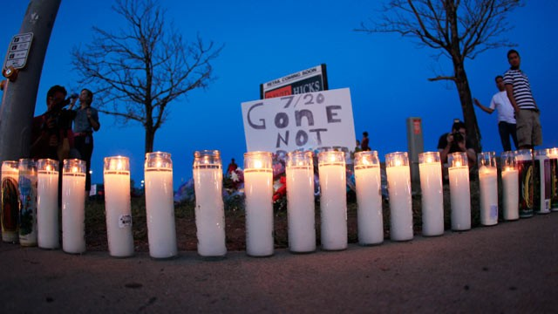
Mental Health Response:
Support Locations
On Scene
Hospitals/Field Hospitals
Family Assistance Centers
Community Vigils
Memorials
Transitioning from Hospital to Home
First Responder organizations
Affected schools and businesses
  115

Slide 116
Other Likely Support Functions
Synchronize psychological support with Victim Service and other ICS functions
Support death notification delivery
Support recovery and victim identification
Support release and disposition of remains (LE, ME/C)
Assist with Ante-Mortem information collection
Support with return of personal effects
Skolnick & Roark, FBI Victim Services, 2013.
  116

Slide 117
Post-Incident Considerations [1]:
VIP Visits
Be prepared for VIP visits and all that this entails in the wake of the incident.
VIPs are likely to attend memorials, funerals, meeting with family members, local officials and first responders.
Such visits require a high degree of collaboration with state and federal agencies, and will be high-profile media events (often worldwide media coverage)
Former President Clinton at Columbine High School.
  117

Slide 118
Post-Incident Considerations [2]:
Family Assistance Centers
In the immediate aftermath of a mass fatality, families and friends will frantically seek assistance.
Family members will gravitate to where they believe they will find their loved one or where they believe they will find information about them.
That translates to the incident site and to local hospitals (thinking their loved ones are injured and have been transported to the nearest hospital).
This is why a center or centers to provide family assistance immediately is so important.
  118

Slide 119
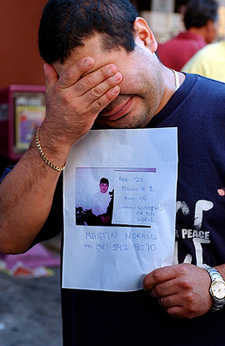
Post-Incident Considerations [3]:
Family Assistance Centers
The Medical Examiner/Coroner Office needs to be prepared to mobilize the appropriate resources to open a family assistance center in addition to managing the incident.
Hospitals will also need to be prepared to mobilize resources to assist families.
If there are large numbers of missing people, even larger numbers of family members will arrive looking for loved ones and for information.
  119

Slide 120
Post-Incident Considerations [4]:
Family Assistance Centers
Anticipate eight to 10 family members per potential victim requesting assistance.
“Family” should be defined broadly and include the many individuals that consider themselves to be the victim’s ‘family,’ even when the law does not formally recognize the relationship.
Family members will begin to come to the incident site almost immediately. The family assistance center—with at least basic services—needs to be open and operating within 24 hours at most.
FAC operations may be long-term.
Responding to a mass fatality incident can be overwhelming, leading to traumatic stress. Support for responders is essential to monitoring and minimizing the impact.
  120

Slide 121
Post-Incident Considerations [5]:
Family Assistance Centers
The purpose of the FAC is to:
Provide a private place for families to grieve.
Protect families from the media and curiosity seekers.
Facilitate information exchange between the ME/C Office and families so that families are kept informed and the ME/C Office can obtain information needed to assist in identifying the victims.
Address family needs (responding quickly and accurately to questions, concerns, and needs—psychological, spiritual, medical and logistical).
Provide death notifications and facilitate the processing of death certificates and the release of human remains for final disposition.
  121

Slide 122
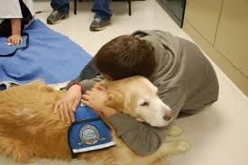
Family Assistance Centers:
Scope of Services
There are many services provided at a FAC. Some require or benefit from behavioral health support:
Family Briefings
Antemortem Data Collection to assist in identifying victims
Death Notifications
Call Center/Hotline
Reception and Information Desk
Spiritual Care Services
Mental Health Services
Medical/First Aid Services
Translation/Interpreter Services
Child care
Food Services
Therapy Dogs are frequently part of the mix of resourses at the FAC.
  122

Slide 123
Challenges to Human Service Response
Spontaneous volunteers / agency responders
Identifying locations to support initial convergence to scene
Family/Victim management
Personal effects management
Interagency collaboration/communication
Coordination and dissemination of information
Skolnick & Roark, FBI Victim Services, 2013.
  123

Slide 124

The Role of the Behavioral Health Responder
Provide psychological and emotional support to:
  Victims
  Survivors
  Responders (including Victim Service workers, others)
  Identify individuals in need of acute mental health intervention
Refer those who may benefit from traditional/ongoing mental health assistance
Connect those in need with resources (ex: National Disaster Distress Helpline)
  124

Slide 125
Lessons Learned:
Delivery of Mental Health Services [1]
Mental health planners should proceed carefully, however, as the ubiquity of counseling offers in the immediate aftermath of these events was often resented.
Local involvement and control are paramount.
At less severe levels of exposure, the impacts of mass shootings extend far beyond the primary victims to encompass the community, whether that is a workplace, neighborhood, school, or campus.
Community members resent the media intrusion and the convergence of outsiders.
Skolnick & Roark, FBI Victim Services, 2013.
  125

Slide 126
Lessons Learned:
Delivery of Mental Health Services [2]
Immediately following traumatic events children and families may benefit from “psychological first aid.”
Calm reassurance, basic education about trauma response, and community assistance can help families feel safer and more in control of their lives.
Remember: Psychotherapy is intended to create change, disaster behavioral health intervention is intended to prevent change and move people back toward baseline functioning.
  126

Slide 127
Lessons Learned:
Delivery of Mental Health Services [3]
Important concepts:
Stay in your own lane.
Understand the value of “compassionate presence.”
Know your own limits; practice good self-care and active stress management.
Maintain a clear reporting and supervisory structure.
Take care not to foster dependence on counselors; Involvement will be time-limited.
Be prepared to partner with many disciplines (i.e.- Clergy, Therapy Dog handlers, Funeral Directors, etc.)
  127

Slide 128
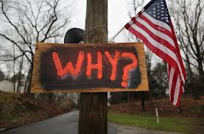
Conclusion
Violence is an admission that one's ideas and goals cannot prevail on their own merits. -Edward Kennedy
  128

Slide 129
Table Top Exercise
Please refer to exercise packet and follow facilitator’s instructions. Thank you.

Slide 130
For More Information
Behavioral Science Applications
info@bsaonline.net
+1.888.404.6177
  130

